Slide 1
Ice Cream Shops of the Commonwealth

Slide 2
Deciding Where to Open a Business is a Difficult Problem
To be successful there must be sufficient demand for your business
Demand can depend on the number of potential customers.
It can also depend on the amount of competition.
Demand for niche businesses like ice cream shops can be easier to predict.

Slide 3
Modeling Can Be Used to Find Promising Locations
A model can be trained to predict how many ice cream shops a town should have based on its demographics.
Comparing the predicted numbers with the actual number of shops can reveal which towns may have an unexploited demand for ice cream shops.
More detailed analysis can be done later on the identified candidate towns.

Slide 4
Goal: Build a Model to Predict the Number of Ice Cream Shops in each town in the State of Massachusetts
Training set: Connecticut town data
Testing set: Massachusetts town data
Input variables: total population, median age, per capita income, average household size, population density
Output variable: number of ice cream shops

Slide 5
Sources of Data
Massachusetts demographic data from Boston.com tables.
Connecticut demographic data from state-provided census data.
Ice cream shop data from Foursquare using venues that are identified with either the ‘ice cream shop’ or ‘frozen yogurt shop’ categories.

Slide 6
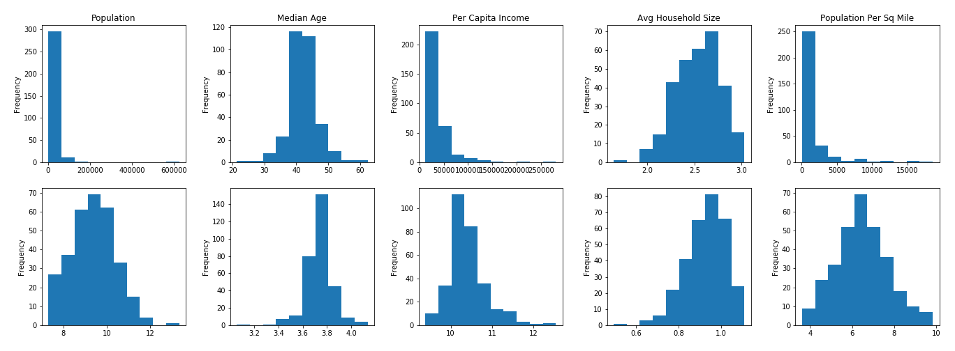
Log Transforms are Required for Some of the Input Data
Massachusetts Data
Original
Log Transformed

Slide 7
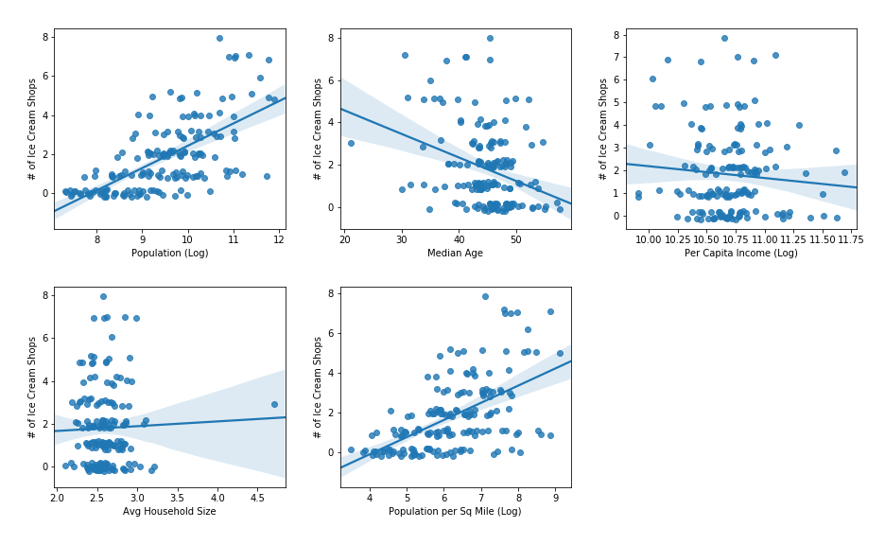
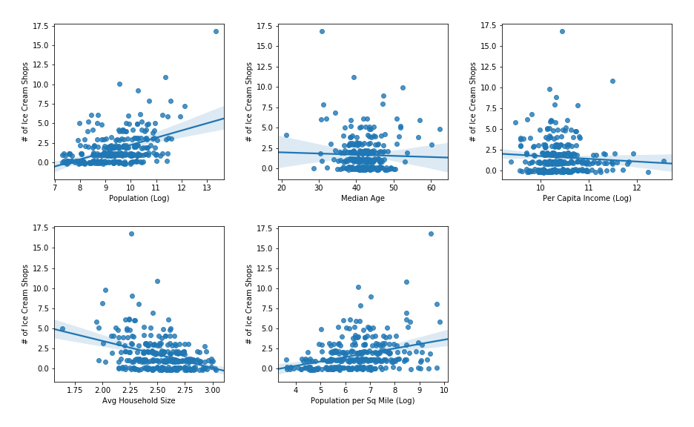
Some Variables Correlate Well With the Number of Ice Cream Shops
Connecticut
Massachusetts

Slide 8
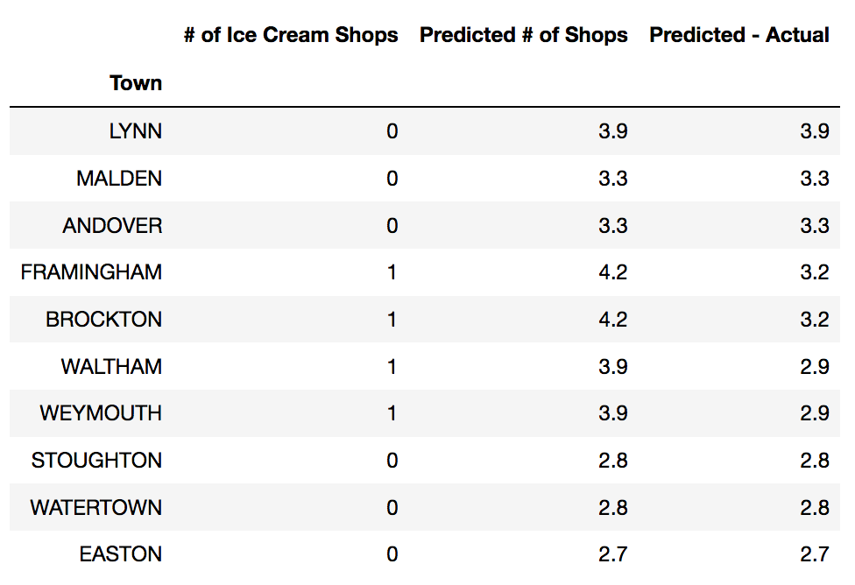
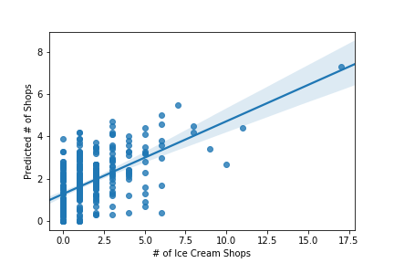
Multiple Linear Regression Model Identifies Candidate Towns With Fewer Than Expected Ice Cream Shops

Slide 9
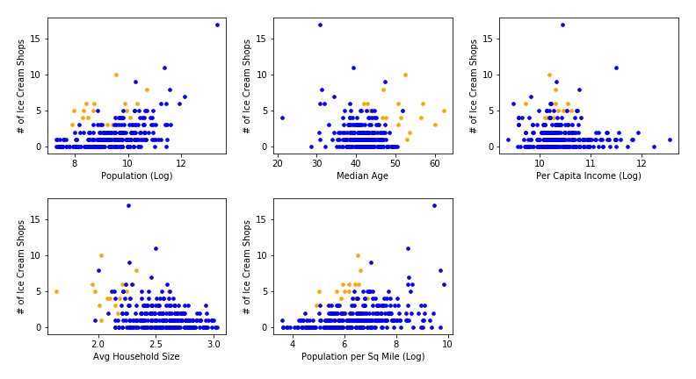
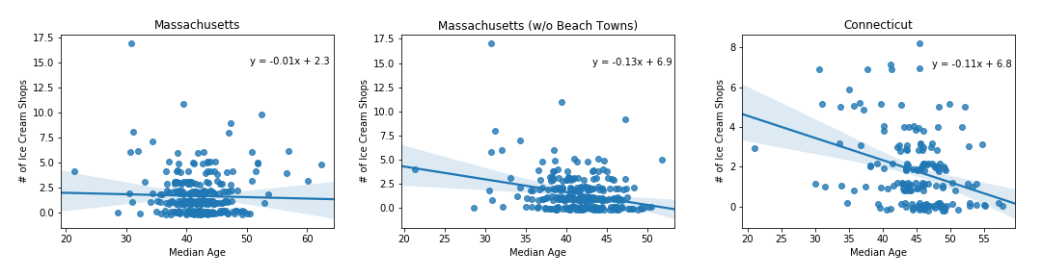
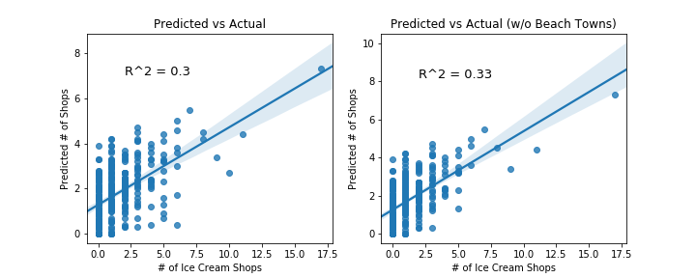
Tourist-Heavy Beach Towns Skew the Analysis
Massachusetts data matches Connecticut data more closely when beach towns excluded.
Model predictions are better without beach towns
Beach towns (orange) are skewed for certain variables

Slide 10
Conclusions
A good number of Massachusetts towns have significantly fewer ice cream shops than expected from the regression model.
Total population size is most predictive factor of how many ice cream shops a town has.
Model would be more powerful with training data that more closely matches the testing data.

